Slide 1
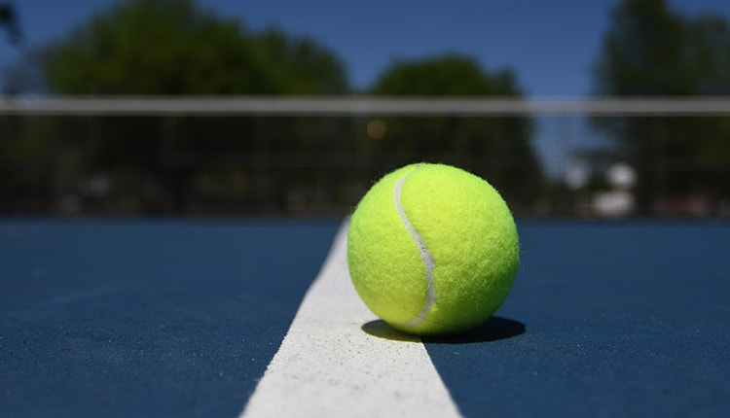


Tennis New Zealand
Youth Advisory Group Y.A.G

Slide 2

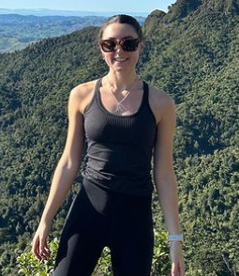
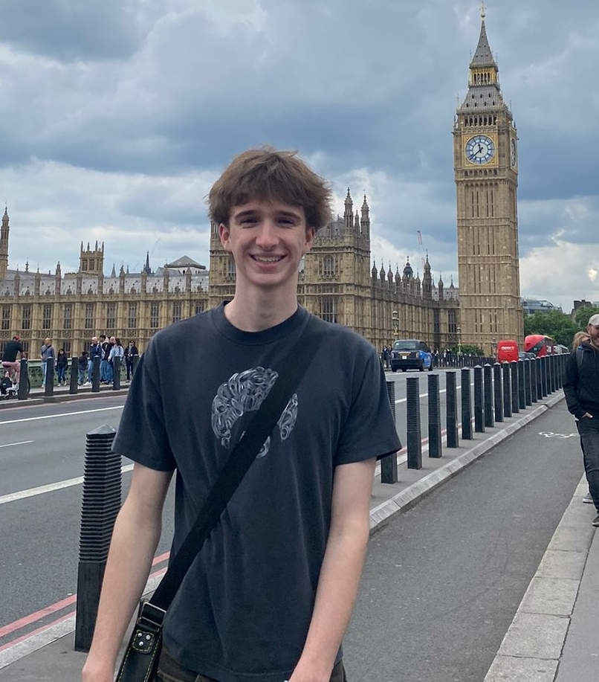
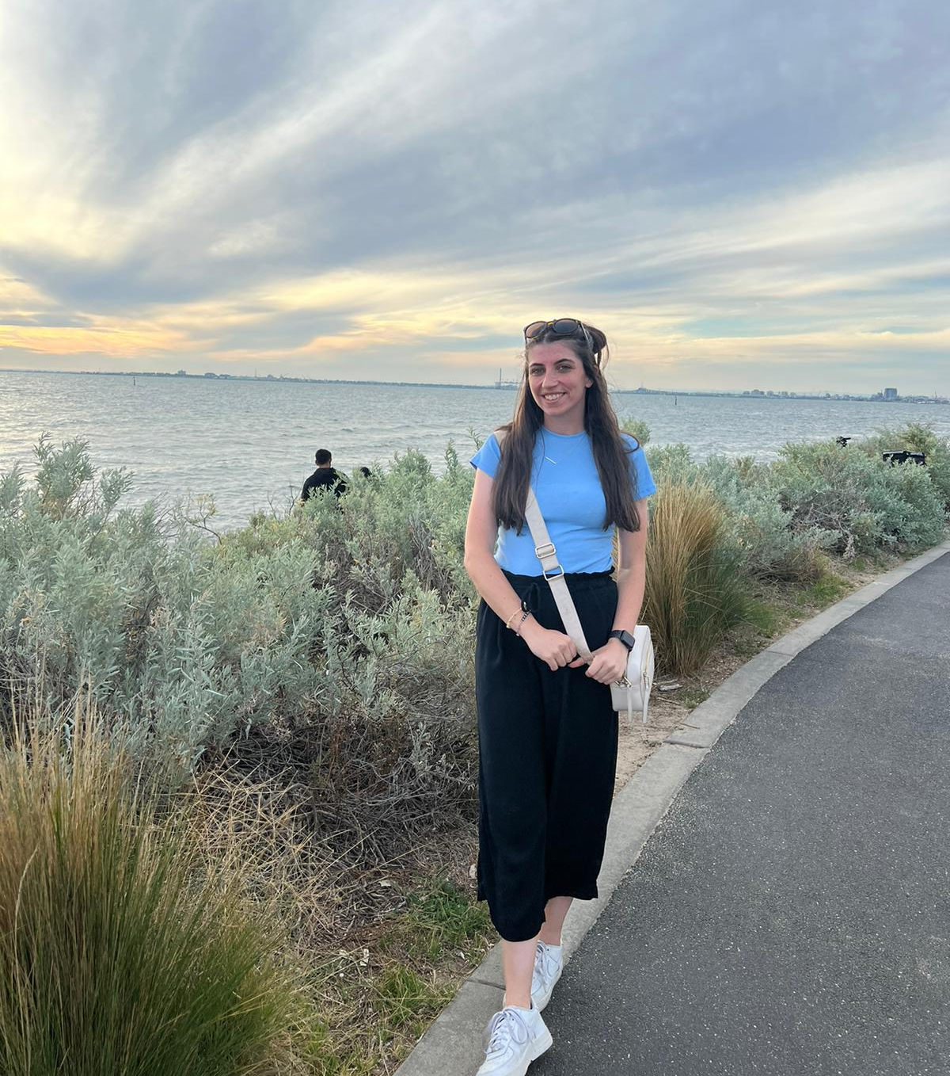
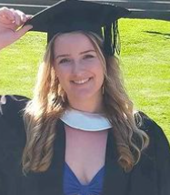
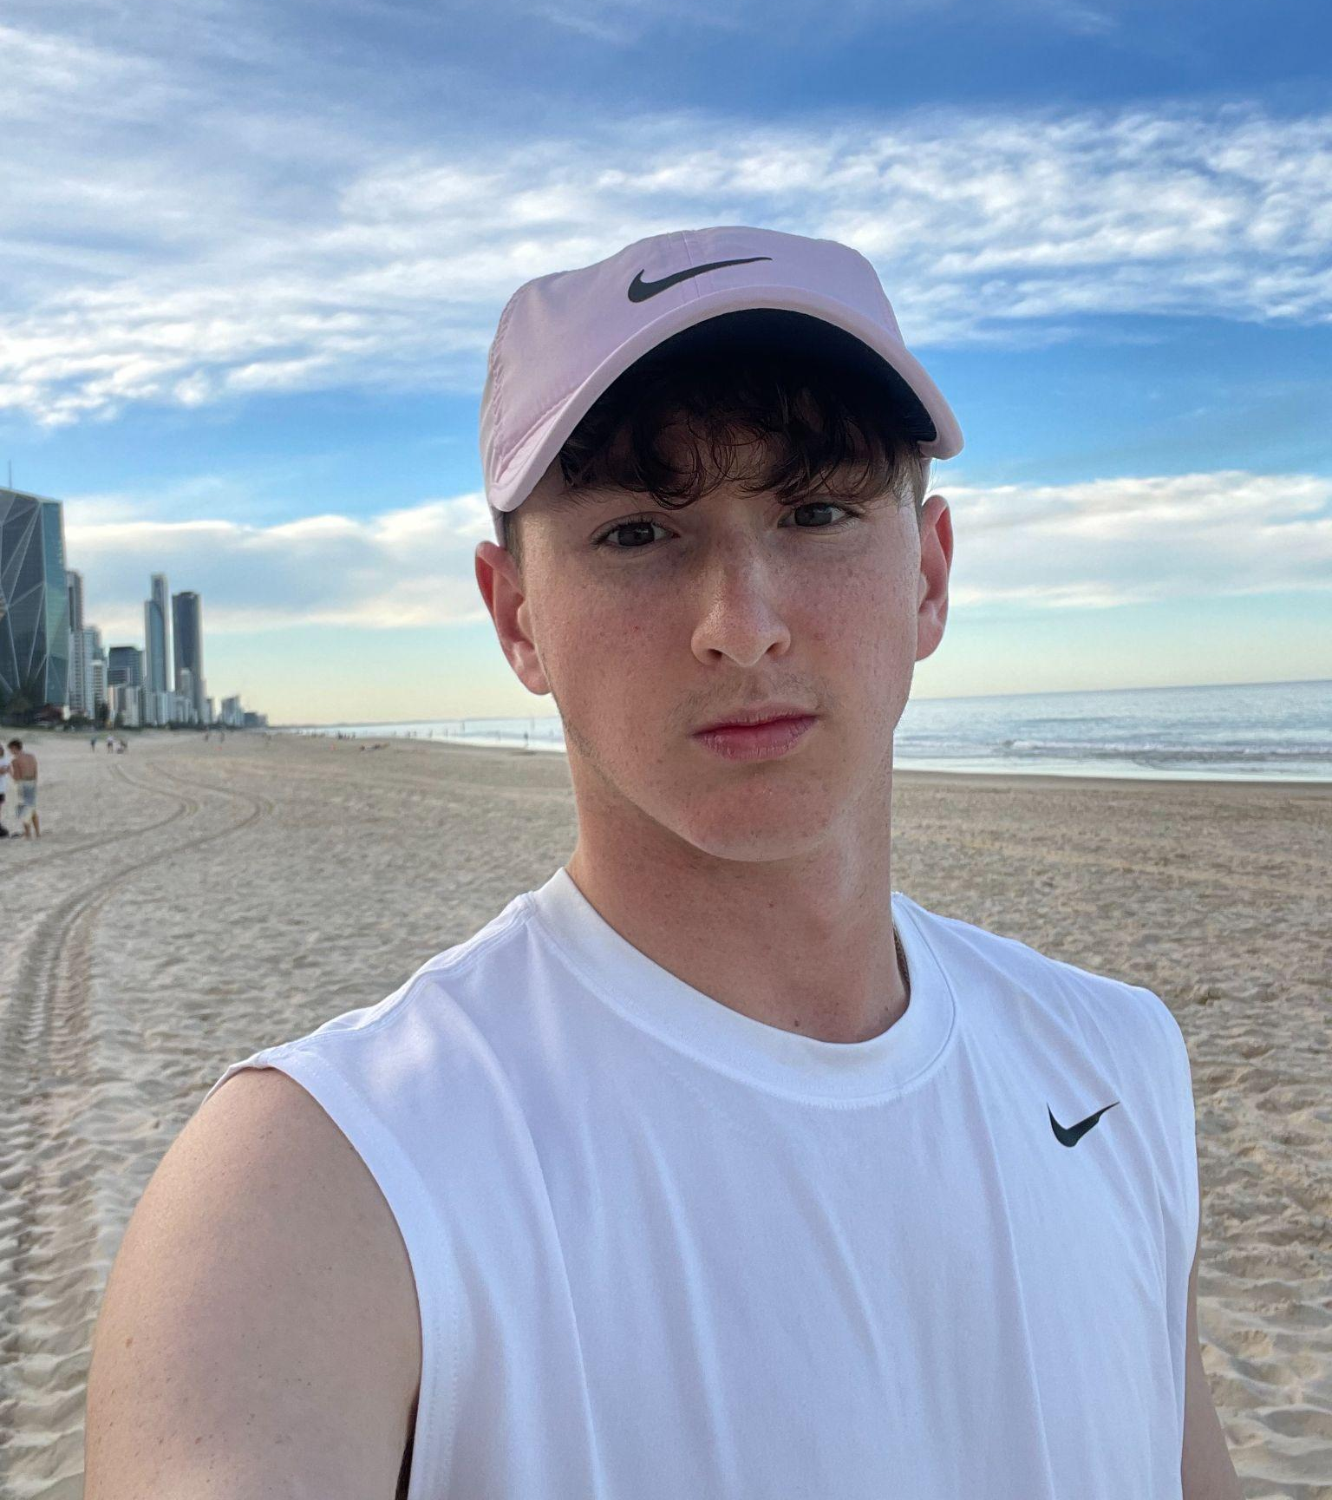
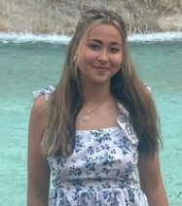
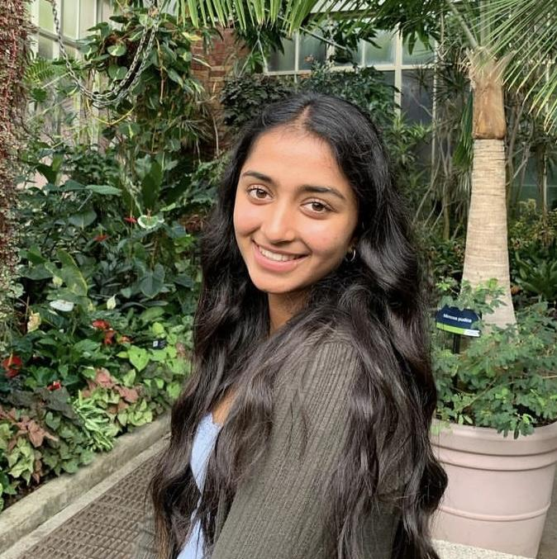
Ella
Ben
Annie
Meet the Team
Tanya
Harry
Hana
Sadheera
Notes:
The Youth Advisory Group for Tennis New Zealand is a dynamic and passionate assembly of young individuals committed to shaping the future of tennis in our country. Comprising avid tennis players, enthusiasts, and advocates, our group represents the diverse perspectives and aspirations of the youth within the tennis community. We are united by a common goal – to contribute actively to the growth, accessibility, and inclusivity of tennis in New Zealand. With a keen understanding of the evolving needs and preferences of our generation, we aim to bridge the gap between tradition and innovation, fostering an environment where tennis not only endures but thrives. The Youth Advisory Group is dedicated to leveraging our collective energy, creativity, and love for the sport to inspire positive change and ensure a vibrant and sustainable future for tennis across all age groups.
Our team members are: Ben (), Ella (), Annie (), Tanya (), Harry (), Hana(),Sadheera (21)

Slide 3
How Y.A.G came to be
Tennis NZ identified the concern of declining participation in youth tennis (aged 12-22) high-school + early 20’s
Youth didn't have a direct voice and impact on the decision making and wanted to come up with a strategy/system to better cater tennis to youth
YAG members joined out of our personal passion to make a difference, give back and improve the sport for youth
Recognised that as a nso the best way to cater to the youth is to connect with them and hear their voice
YAG allows youth to connect with other youth to share their insights and perspective on Tennis in NZ

Slide 4
Strategic Framework 2024-2027
VISION | TENNIS - ACCESSIBLE AND THRIVING
PURPOSE | INFLUENCE THE FUTURE OF TENNIS IN NEW ZEALAND
PILLARS | ACCESSIBILITY | FUN & SOCIAL | ENGAGE
 | Increase the overall accessibility of tennis | Ensure tennis is a positive and enjoyable experience for all | Attract and retain tamariki and rangatahi members
Notes:
Our vision aligns with TNZ vision.

Slide 5
Our Two Focus Areas
Technology and Innovation
Market research - discover new ways to connect and engage with youth, allowing us & regions to connect through platforms youth utilise regularly.
Grow the YAG Instagram account outreach & promote the fun and social aspects of tennis.
Promote court accessibility and book a court for youth
Measures of success
Monitor engagement metrics through social media
Increased engagement and followers by 25%,
Future development opportunities = work with Tennis NZ to create engaging content beyond tennis via tik tok
Participation and Development
Working on surveys/gathering data and information
Annual survey on Accessibility
Love Tennis annual surveys
ASB classic annual surveys
Measures of success
Achieve 75% comprehension rate among rangatahi regarding court availability and accessibility
80% of survey participants report better accessibility in key areas (environmental, physical, financial, inclusivity)
Identification and communication of barriers to accessibility to reliant clubs and bodies for action.

Slide 6
Main Goals for 2024
Increase marketing - gain more awareness of what “YAG” is and our objectives
Build a strong relationship with the Tennis NZ Board & provide surveys/resources for regions to pass on to clubs
Create and conduct an annual participation survey
Involvement with Love Tennis - Interact with youth at the events
Develop & begin to implement our 3 year strategic plan
Further focus on internal focus areas and the longevity of YAG as a youth body
Share and expand the YAG strategy with region and association boards, aim to get it down to club level
Notes:
Talk about the smart goals

Slide 7
How Can YAG and Regions Support One Another?
By you… | Sharing our surveys with regional boards, clubs, and players | Sharing our YAG Instagram | Encouraging clubs to start/continue to engage with youth | Encouraging clubs to start their own social media pages
YAG can… | - Collect useful data - Provide regions and TNZ with this data, work together to digest and respond to it | - Connect with youth across NZ - Promote tennis as a sport to our audience - Share and promote our work and get youth engaged with it | - Provide ideas and insight about how clubs can best go about this (from a youth perspective) - Help get more youth connected with regions and with YAG | - Provide them with templates/ideas on how to do this - Share examples of successful club social media pages

Slide 8
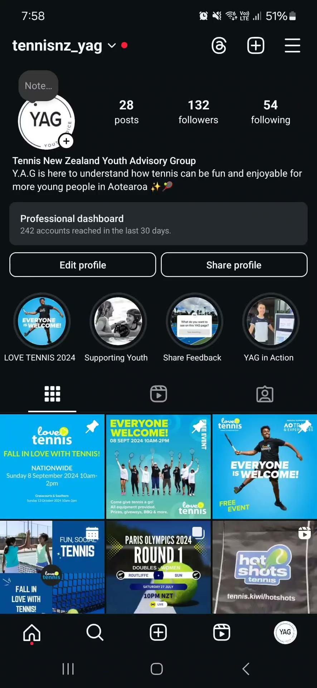

Any
Questions
Follow us on Instagram @tennisnz_yag

